Slide 1

HSM

Slide 2
Introduction To HSM
What is a hardware security module (HSM)?
A hardware security module (HSM) is a physical device that provides extra security for sensitive data. This type of device is used to provision cryptographic keys for critical functions such as encryption, decryption and authentication for the use of applications, identities and databases.
What is HSM in finance?
To protect sensitive data, organizations rely on Hardware Security Modules (HSMs) that provide encryption, key management, and digital signature services. This article will explore the HSM use cases in the finance industry and how HSMs contribute to securing the financial sector.

Slide 3
How do HSMs work?
Securing the keys in a cryptographic system is critical to maintaining a secure system. However, managing the lifecycle of those keys is a challenge. And that's where HSMs come in.
They manage all aspects of a cryptography key's lifecycle, including the following six steps:
Provisioning
Keys are created by an HSM, another type of key management system or a third-party organization that does this. A true random number generator should be used to create keys.
Backup and storage
A copy of a keys should be made and securely stored, in case the key is compromised or lost. They can be stored in the HSM or on external media. Private keys must be encrypted before being stored.
Deployment
This involves installing the key in a cryptographic device such as an HSM.

Slide 4
How do HSMs work?(Contd.)
Management
Keys are controlled and monitored based on industry standards and an organization's own internal policies. The encryption key management system handles key rotation where new keys are deployed as existing keys expire.
Archiving
Decommissioned keys are put in offline, long-term storage for when they may be needed to access existing data that was encrypted with that key.
Disposal
Keys should be securely and permanently destroyed only after it is determined that they are no longer needed.
The hardware security module protects cryptographic keys and handles the encryption and decryption processes.

Slide 5
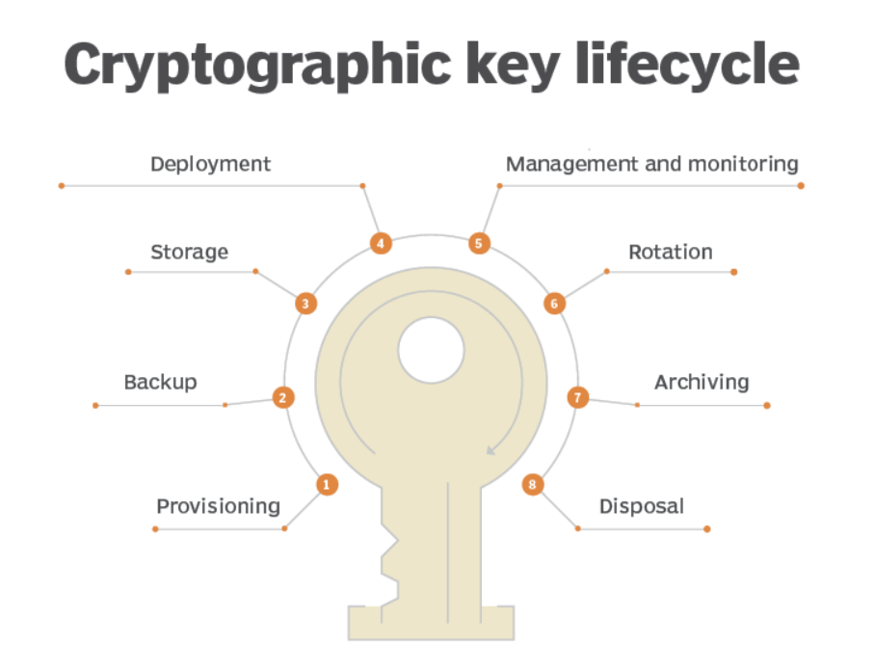
HSMs manage the entire lifecycle of cryptographic keys.

Slide 6
How are HSMs used?
Any business that handles valuable or sensitive information should consider using a hardware security module. That type of information includes credit or debit card data, intellectual property, customer data and employee information. HSMs secure data generated by a range of applications, including the following:
Websites
Banking
Mobile payments
Cryptocurrencies
Smart meters
Medical devices
Identity cards and personal identification numbers (PINs)
Digital documents

Slide 7
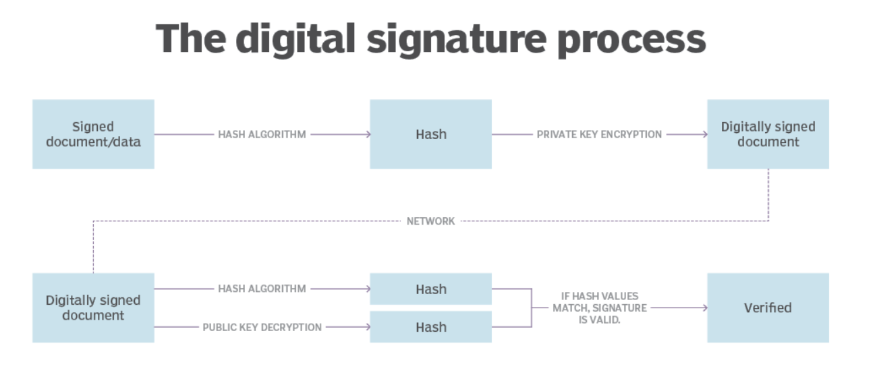
Digital signatures are created using a private key to encrypt the signature. The recipient uses the signer's public key to decrypt the signature.

Slide 8
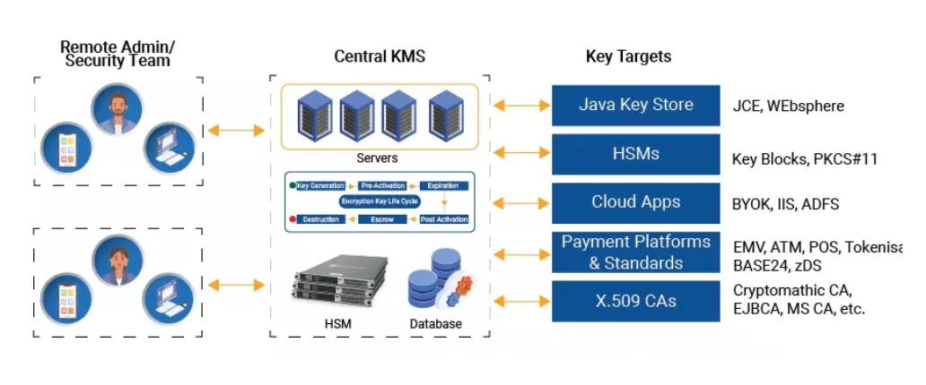
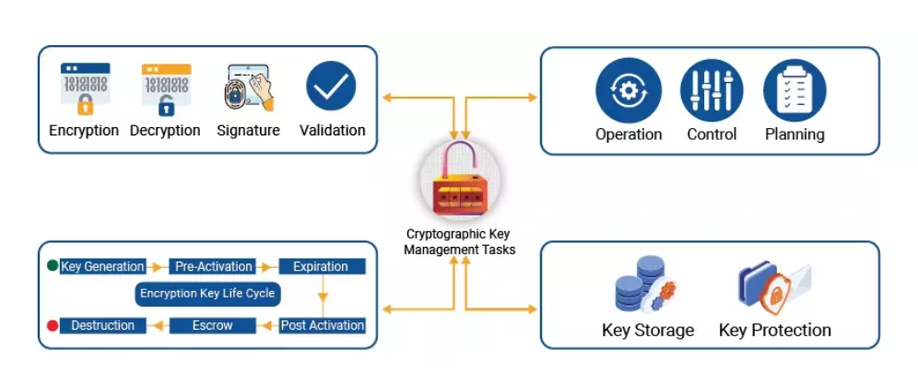
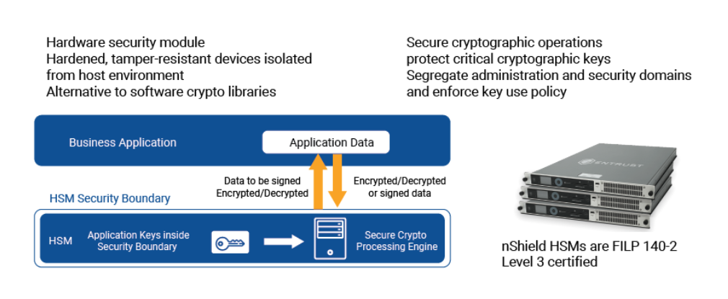

Slide 9
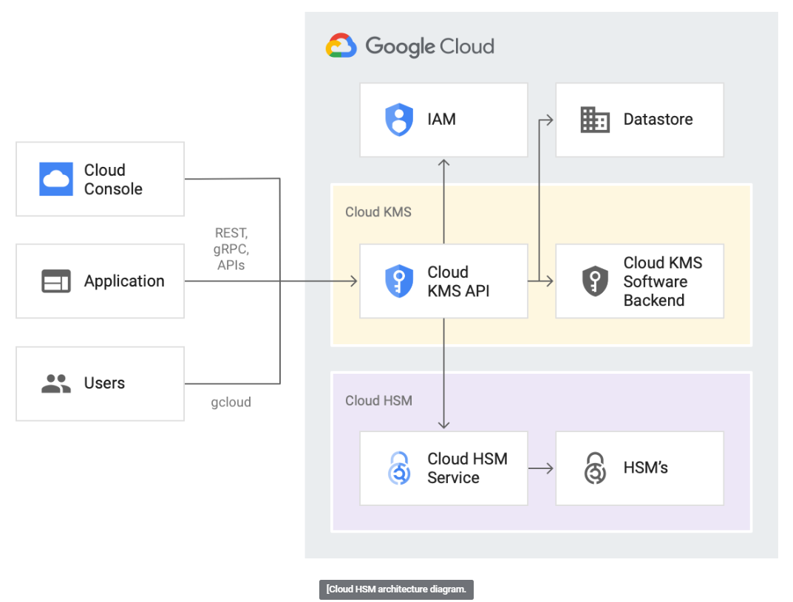
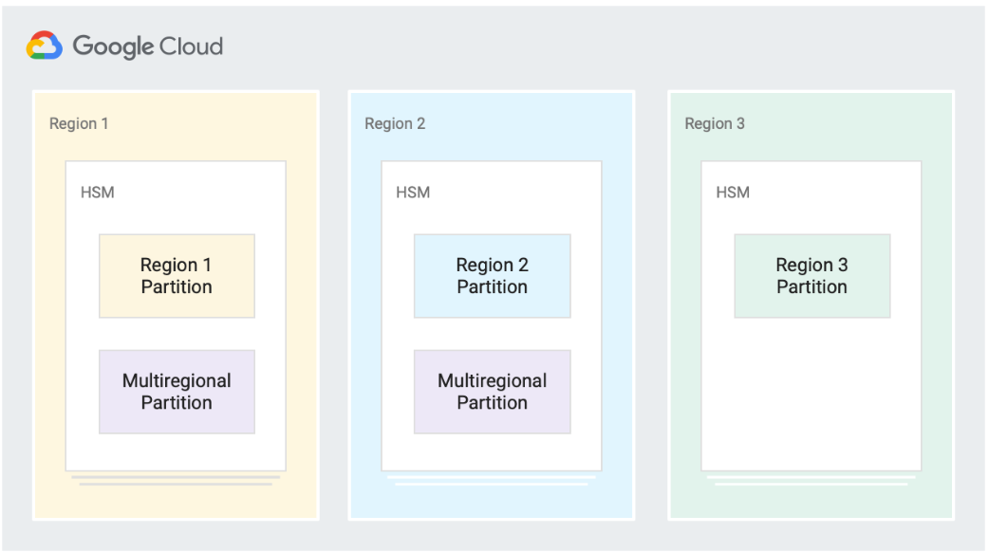

Slide 10
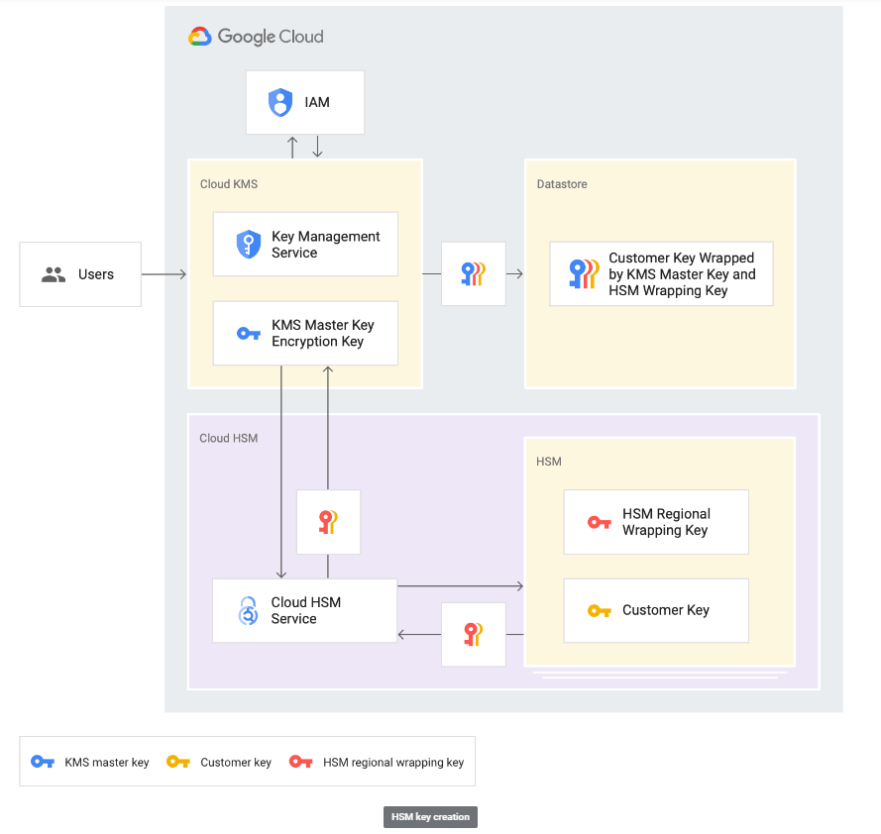
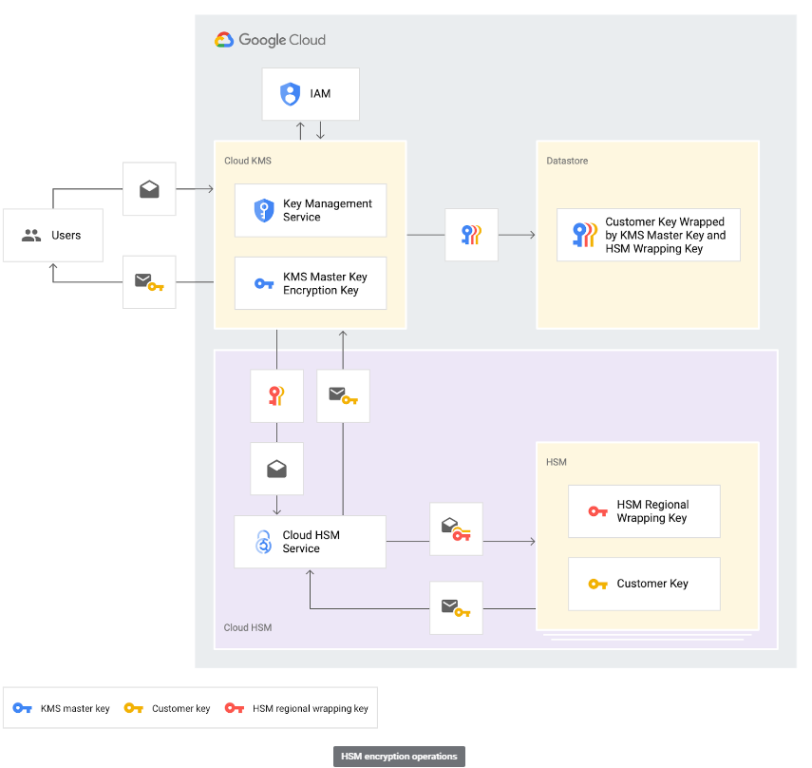

Slide 11
Complete list of Thales HSM commands

Slide 12
Host Command (Response) | Function | Supported by BP-HSM | Note
A0 (A1) | Generate a Key | X
A2 (A3, AZ) | Generate and Print a Component |  | Printer handling
A4 (A5) | Form a Key from Encrypted Components | X
A6 (A7) | Import a Key | X
A8 (A9) | Export a Key | X
AA (AB) | Translate a TMK, TPK or PVK
AC (AD) | Translate a TAK
AE (AF) | Translate a TMK, TPK or PVK from LMK to Another TMK, TPK or PVK | X
AG (AH) | Translate a TAK from LMK to TMK Encryption | X
AQ (AR) | Translate an RSA-encrypted PIN to a ZPK or TPK-encrypted | X
AS (AT) | Generate a CVK Pair
AU (AV) | Translate a CVK Pair from LMK to ZMK Encryption | X
AW (AX) | Translate a CVK Pair from ZMK to LMK Encryption | X
AY (AZ) | Translate a CVK Pair from Old LMK to New LMK Encryption
B0 (B1) | Translate Key Scheme | X
B2 (B3) | Echo Command | X
BA (BB) | Encrypt a Clear PIN | X
BC (BD) | Verify a Terminal PIN Using the Comparison Method | X
BE (BF) | Verify an Interchange PIN Using the Comparison Method | X
BG (BH) | Translate a PIN and PIN Length |  | Missing KEY CHANGE STORAGE
BI (BJ) | Generate a BDK | X
BK (BL) | Generate an IBM PIN Offset (of a customer selected PIN) | X
BM (BN) | Load the Excluded PIN Table
BQ (BR) | Translate PIN Algorithm
BS (BT) | Erase the Key Change Storage
BU (BV) | Generate a Key Check Value | X
BW (BX) | Translate Keys from Old LMK to New LMK
BY (BZ) | Translate ZMK from ZMK to LMK encryption
C0 (C1) | Generate Initial Terminal Master Keys (AS2805) | X | Term
C2 (C3) | Generate a MAC (Message Authentication Code, large messages) (AS2805) | X
C4 (C5) | Verify MAC (Message Authentication Code, large messages) (AS2805) | X
C6 (C7) | Generate a Random Number (AS2805) | X | Term
C8 (C9) | Generate an Acquirer Master Key Encrypting Key (AS2805) |  | Term
CA (CB) | Translate a PIN from TPK to ZPK Encryption | X
CC (CD) | Translate a PIN from One ZPK to Another | X
CE (CF) | Generate a Diebold PIN Offset
CG (CH) | Verify a Terminal PIN Using the Diebold Method | X | Custom Code
CI (CJ) | Translate a PIN from BDK to ZPK Encryption (DUKPT) | X
CK (CL) | Verify a PIN Using the IBM Method (DUKPT) | X
CM (CN) | Verify a PIN Using the VISA PVV Method (DUKPT) | X
CO (CP) | Verify a PIN Using the Diebold Method (DUKPT)
CQ (CR) | Verify a PIN Using the Encrypted PIN Method (DUKPT)
CS (CT) | Modify Key Block Header | X
CU (CV) | Verify & Generate a VISA PVV (of a customer selected PIN) | X
CW (CX) | Generate a Card Verification Code/Value | X
CY (CZ) | Verify a Card Verification Code/Value | X
D0 (D1) | Generate a PIN Pad Authentication Code (AS2805) | X | Term
D2 (D3) | Verify a PIN pad Authentication code (AS2805) | X | Term

Slide 13
D4 (D5) | Translate a PIN Block to Encryption under a PIN Encryption Key (AS2805) |  | Term
D6 (D7) | Translate an Acquirer Master Key Encrypting Key (AS2805) |  | Term
D8 (D9) | Encrypt a CPAT Authentication Value (AS2805) |  | Term
DA (DB) | Verify a Terminal PIN Using the IBM Method | X
DC (DD) | Verify a Terminal PIN Using the VISA Method | X
DE (DF) | Generate an IBM PIN Offset (of an LMK encrypted PIN) | X
DG (DH) | Generate a VISA PIN Verification Value (of an LMK encrypted PIN) | X
DI (DJ) | Generate and Export a KML
DK (DL) | Import a KML
DM (DN) | Verify Load Signature S1 and Generate Load Signature S2
DO (DP) | Verify Load Completion Signature S3
DQ (DR) | Verify Unload Signature S1 and Generate Unload Signature S2
DS (DT) | Verify Unload Completion Signature S3
DU (DV) | Verify & Generate an IBM PIN Offset (of customer selected new PIN) | X
DW (DX) | Translate a BDK from ZMK to LMK Encryption | X
DY (DZ) | Translate a BDK from LMK to ZMK Encryption | X
E0 (E1) | Generate a KEKs Validation Request (AS2805) | X
E2 (E3) | Generate a KEKr Validation Response (AS2805) | X
E4 (E5) | Verify a PIN Pad Proof of End Point (POEP) (AS2805) | X | Term
E6 (E7) | Generate a PIN Pad Proof of Endpoint (AS2805) |  | Term
E8 (E9) | Generate a KCA and KMACH (AS2805) |  | Term
EA (EB) | Verify an Interchange PIN Using the IBM Method | X
EC (ED) | Verify an Interchange PIN Using the VISA Method | X
EE (EF) | Derive a PIN Using the IBM Method | X
EG (EH) | Verify an Interchange PIN Using the Diebold Method | X | Custom Code
EI (EJ) | Generate an RSA Key Set | X
EK (EL) | Load an RSA Secret Key | X
EM (EN) | Translate an RSA Secret Key
EO (EP) | Import a Public Key (Generate a MAC on an RSA Public Key) | X
EQ (ER) | Validate a Public Key (Verify a MAC on an RSA Public Key) | X
ES (ET) | Validate a Certificate and Generate a MAC on its RSA Public Key | X
EU (EV) | Translate a MAC on an RSA Public Key
EW (EX) | Generate an RSA Signature | X
EY (EZ) | Validate an RSA Signature | X
F0 (F1) | Verify a Terminal PIN using the IBM Method (AS2805) | X | Term
F2 (F3) | Verify a Terminal PIN using the VISA Method (AS2805) | X | Term
F4 (F5) | Calculate KMACI |  | Term
F6 (F7) | KEKGEN (AS2805)
F8 (F9) | KEKREC (AS2805)
FA (FB) | Translate a ZPK from ZMK to LMK Encryption | X
FC (FD) | Translate a TMK, TPK or PVK from ZMK to LMK Encryption | X
FE (FF) | Translate a TMK, TPK or PVK from LMK to ZMK Encryption | X
FG (FH) | Generate a Pair of PVKs | X
FI (FJ) | Generate ZEK/ZAK | X
FK (FL) | Translate a ZEK/ZAK from ZMK to LMK Encryption | X
FM (FN) | Translate a ZEK/ZAK from LMK to ZMK Encryption | X
FO (FP) | Generate a Watchword Key
FQ (FR) | Translate a Watchword Key from LMK to ZMK Encryption | X
FS (FT) | Translate a Watchword Key from ZMK to LMK Encryption | X
FU (FV) | Verify a Watchword Response
FW (FX) | Generate a VISA PIN Verification Value (of a customer selected PIN) | X
G0 (G1) | Translate a PIN from BDK to ZPK Encryption (3DES DUKPT) | X

Slide 14
GA (GB) | Derive a PIN Using the Diebold Method
GC (GD) | Translate a ZPK from LMK to ZMK Encryption | X
GE (GF) | Translate a ZMK
GG (GH) | Form a ZMK from Three ZMK Components
GI (GJ) | Import Key under an RSA Public Key | X
GK (GL) | Export Key under an RSA Public Key | X
GM (GN) | Hash a Block of Data | X
GO (GP) | Verify a PIN Using the IBM Method (3DES DUKPT) | X
GQ (GR) | Verify a PIN Using the VISA PVV Method (3DES DUKPT) | X
GS (GT) | Verify a PIN Using the Diebold Method (3DES DUKPT) | –
GU (GV) | Verify a PIN Using the Encrypted PIN Method (3DES DUKPT) | X | Custom Code
GW (GX) | Generate/Verify a MAC (3DES DUKPT) | X
GY (GZ) | Form a ZMK from 2 to 9 ZMK Components | X
H0 (H1) | Decrypt a PIN Pad Public Key (AS2805) |  | Term
H2 (H3) | Generate a RSA Public Key Verification Code (AS2805)
H4 (H5) | Generate a KEKs for use in Node to Node interchange using RSA (AS2805)
H6 (H7) | Receive a KEKr for use in Node to Node interchange using RSA (AS2805)
H8 (H9) | Encrypt a Cross Acquirer Key Encrypting Key under an Initial Transport Key (AS2805) |  | Term
HA (HB) | Generate a TAK | X
HC (HD) | Generate a TMK, TPK or PVK | X
I0 (I1) | Encrypt a Terminal Key under the Local Master Key (AS2805) |  | Term
I2 (I3) | Import MULTOS Transport Key Certifying Key |  | EMV Issuing
I4 (I5) | Import MULTOS Hash Modulus Key |  | EMV Issuing
I6 (I7) | Translate MULTOS KTU |  | EMV Issuing
I8 (I9) | MULTOS ALU Generator |  | EMV Issuing
IA (IB) | Generate a ZPK | X
IC (ID) | Establish Secure Session with Chip Card |  | EMV Issuing
IE (IF) | Prepare Secure Message for Chip Card |  | EMV Issuing
JA (JB) | Generate a Random PIN | X
JC (JD) | Translate a PIN from TPK to LMK Encryption | X
JE (JF) | Translate a PIN from ZPK to LMK Encryption | X
JG (JH) | Translate a PIN from LMK to ZPK Encryption | X
K0 (K1) | Verify Encrypted Counters (EMV
K2 (K3) | Verify Truncated Application Cryptogram (MasterCard CAP)
K8 (K9) | Export a Key under a KEK
KA (KB) | Generate a Key Check Value (Not Double-Length ZMK) | X
KC (KD) | Translate a ZPK
KE (KF) | Generate Issuer RSA Key Set and Public Key Certificate |  | EMV Issuing
KG (KH) | Validate an Issuer Public Key Certificate |  | EMV Issuing
KI (KJ) | Derive Card Unique DES Keys |  | EMV Issuing
KK (KL) | Import a Certification Authority Self-Signed Certificate |  | EMV Issuing
KM (KN) | Generate Static Data Authentication Signature |  | EMV Issuing
KO (KP) | Generate Card RSA Key Set and Public Key Certificate |  | EMV Issuing

Slide 15
KQ (KR) | ARQC Verification and/or ARPC Generation (EMV 3.1.1) | X
KS (KT) | Data Authentication Code and Dynamic Number Verification (EMV 3.1.1) | X
KU (KV) | Generate Secure Message (EMV 3.1.1)
KW (KX) | ARQC Verification and/or ARPC Generation (EMV 4.x) | X
KY (KZ) | Generate Secure Message (EMV 4.x)
L0 (L1) | Generate an HMAC Secret Key | X
LA (LB) | Load Data to User Storage
LC (LD) | Verify the Diebold Table in User Storage
LE (LF) | Read Data from User Storage
LG (LH) | Set HSM Response Delay | X | Custom Code, no real functionality yet
LI (LJ) | Load a PIN Text String
LK (LL) | Generate a Decimal MAC
LM (LN) | Verify a Decimal MAC
LO (LP) | Translate Decimalisation Table from Old to New LMK
LQ (LR) | Generate an HMAC on a Block of Data
LS (LT) | Verify an HMAC on a Block of Data
LU (LV) | Import an HMAC key under a ZMK
LW (LX) | Export an HMAC key under a ZMK | X
LY (LZ) | Translate a HMAC Key from Old LMK to New LMK
M0 (M1) | Encrypt Data Block | X
M2 (M3) | Decrypt Data Block | X
M4 (M5) | Translate Data Block | X
M6 (M7) | Generate MAC | X
M8 (M9) | Verify MAC | X
MA (MB) | Generate a MAC
MC (MD) | Verify a MAC
ME (MF) | Verify and Translate a MAC
MG (MH) | Translate a TAK from LMK to ZMK Encryption | X
MI (MJ) | Translate a TAK from ZMK to LMK Encryption | X
MK (ML) | Generate a Binary MAC
MM (MN) | Verify a Binary MAC
MO (MP) | Verify and Translate a Binary MAC
MQ (MR) | Generate MAC (MAB) for Large Message
MS (MT) | Generate MAC (MAB) using ANSI X9.19 Method for a Large Message
MY (MZ) | Verify and Translate MAC | X
N0 (N1) | Generate a Random Value | X
NC (ND) | Perform Diagnostics | X
NE (NF, NZ) | Generate and Print a Key as Split Components
NG (NH) | Decrypt an Encrypted PIN | X
NI (NJ) | Return Network Information
NK (NL) | Command Chaining | X
NO (NP) | HSM Status | X
NY (NZ) | Generate IVCVC3 and Static CVC3 |  | EMV Issuing

Slide 16
OA (OB, OZ) | Print a PIN Solicitation Mailer
OC (OD, OZ) | Generate and Print a ZMK Component
OE (OF, OZ) | Generate and Print a TMK, TPK or PVK
OI (OJ) | Generate a Set of Zone Keys (AS2805) | X
OK (OL) | Translate a Set of Zone Keys to Encryption under the Local Master Key (AS2805) | X
OU (OV) | Update Terminal Master Key 1 (Roll KEK 1) (AS2805) | X | Term
OW (OX) | Update Terminal Master Keys (Roll KEK 1 and KEK 2) (AS2805) | X | Term
P2 (P3) | Generate a VISA PVV (AS2805) |  | Term
P4 (P5) | Generate a Proof of Host value (AS2805) |  | Term
PA (PB) | Load Formatting Data to HSM | X
PC (PD) | Load Additional Formatting Data to HSM
PE (PF, PZ) | Print PIN/PIN and Solicitation Data | X
PG (PH) | Verify PIN/PIN and Solicitation Mailer Cryptography
PI (PJ) | Generate Terminal Key Set (AS2805) | X | Term
PK (PL) | Generate a PIN Pad Acquirer Security Number (AS2805) |  | Term
PM (PN) | Verify a Dynamic CVV (dCVV) | X
PO (PP) | Verify and Generate a VISA PVV, translate a PIN Block to Encryption under a Zone PIN Key (AS2805) | X | Term
PQ (PR) | Generate a Message Authentication Code AS2805-1988 (AS2805)

Slide 17
PS (PT) | Validate a Message Authentication Code AS2805-1988 (AS2805)
PU (PV) | Encrypt data (AS2805) | X
PW (PX) | Decrypt data (AS2805) | X
PY (PZ) | Verify and Generate an IBM PIN Offset (AS2805) |  | Term
Q0 (Q1) | Translate Audit Record MAC key
Q2 (Q3) | Retrieve Audit Record
Q4 (Q5) | Archive (Print) Audit Record
Q6 (Q7) | Delete Audit Record
Q8 (Q9) | Audit Record Verification
QA (QB) | Load Solicitation Data to User Storage
QC (QD) | Final Load of Solicitation Data to User Storage
QI (QJ) | Translate a PPASN from old to new LMK (AS2805) |  | Term
QM (QN) | Data Encryption Using a Derived Privacy Key (AS2805.6.2) |  | Term
QO (QP) | Data Decryption Using a Derived Privacy Key (AS2805.6.2) |  | Term
QQ (QR) | Verify a PIN at Card Issuer using IBM Method (AS2805.6.2) |  | Term
QS (QT) | Verify a PIN at Card Issuer using the Diebold Method (AS2805.6.2) |  | Term
QU (QV) | Verify a PIN at Card Issuer using Visa Method (AS2805.6.2) |  | Term
QW (QX) | Verify a PIN at Card Issuer using the Comparison Method (AS2805.6.2) |  | Term
RA (RB) | Cancel Authorised Activities
RC (RD) | Verify Solicitation Mailer Cryptography
RE (RF) | Verify a Transaction Request, without PIN (AS2805.6.2) |  | Term
RG (RH) | Verify a Transaction Request, with PIN, when CD Field Available (AS2805.6.2) |  | Term
RI (RJ) | Verify a Transaction Request, with PIN, when CD Field not Available (AS2805.6.2) |  | Term
RI (RJ) | Transaction Request With a PIN (T/AQ Key)
RK (RL) | Generate Transaction Response, with Auth Para Generated by Acquirer (AS2805.6.2) |  | Term
RK (RL) | Transaction Request Without a PIN
RM (RN) | Generate Transaction Response with Auth Para Generated by Card Issuer (AS2805.6.2) |  | Term
RM (RN) | Administration Request Message
RO (RP) | Translate a PIN from PEK to ZPK Encryption (AS2805.6.2) |  | Term

Slide 18
RO (RP) | Transaction Response with Auth Para from Card Issuer
RQ (RR) | Verify a Transaction Completion Confirmation Request (AS2805.6.2) |  | Term
RQ (RR) | Generate Auth Para and Transaction Response
RS (RT) | Generate a Transaction Completion Response (AS2805.6.2) |  | Term
RS (RT) | Confirmation
RU (RV) | Generate Auth Para at the Card Issuer (AS2805.6.2) |  | Term
RU (RV) | Transaction Request With a PIN (T/CI Key)
RW (RX) | Generate an Initial Terminal Key (AS2805.6.2) |  | Term
RW (RX) | Translate KEYVAL
RY (RZ) | Calculate Card Security Codes
RY (RZ) | Verify Card Security Codes
RY (RZ) | Generate a CSCK
RY (RZ) | Export a CSCK
RY (RZ) | Import a CSCK
SC (SD)
SE (SF)
SI (SJ)
SK (SL) | Generate ZAK, ZPK under BDK and MAC, PAC random numbers (Shell)
TA (TB, TZ) | Print TMK Mailer

Slide 19
Important Cryptographic Keys

Slide 20
Cryptographic Keys
Local Master Key (LMK)
The LMK is a high-level cryptographic key used to encrypt and protect other keys within a local system or environment. It's essentially the top-level key in a key hierarchy.
Data Encryption Keys (DEKs)
Under the LMK, you have Data Encryption Keys (DEKs). DEKs are used for encrypting actual data, such as files, messages, or database records.

Slide 21
Cryptographic Keys
Zone Master Key (ZMK)
A Zone Master Key (ZMK) is a critical cryptographic key. It's used for encrypting and decrypting other keys, such as the Data Encryption Keys (DEKs) or PIN Encryption Keys (PEKs), which are then used for securing sensitive data like cardholder information or personal identification numbers (PINs).
Key Encryption Keys (KEKs)
To add another layer of security, there might be Key Encryption Keys (KEKs). KEKs are used to encrypt DEKs, making it more secure to manage and transport DEKs.
This hierarchical structure adds an extra layer of security because compromising the DEKs doesn't immediately reveal the actual data. An attacker would also need access to the KEKs and ultimately the LMK to decrypt the DEKs and access the data.

Slide 22
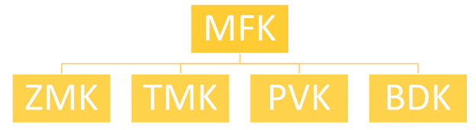

Cryptographic Keys(Contd.)
Master File Key (MFK) is a symmetric key used to encrypt other cryptographic keys which are to be stored outside of the hardware security module (HSM).
This key exists only in HSM and secure backups.
Profiles define distinct HSM configurations as required by security standards for payments use cases.
it sits at the top of the chart and is present in each HSM.
This key is used to encrypt the next tier in this hierarchy.
This key is not shared outside of the HSM.

Slide 23
HSM Specifications & Requirements

Slide 24
HSM Requirements
MOSIP(Modular Open-Source Identity Platform) highly recommends the following specifications for HSM:
1.Must support cryptographic offloading and acceleration.
2.Should provide Authenticated multi-role access control.
3.Must have strong separation of administration and operator roles.
4.Capability to support client authentication.
5.Must have secure key wrapping, backup, replication and recovery.
6.Must support 2048, 4096-bit RSA Private Keys, 256-bit AES keys on FIPS 140-2 Level 3 Certified Memory of Cryptographic Module.
7.Must support at least 10000+ 2048 RSA Private Keys on FIPS 140-2 Level 3 Certified Memory of Cryptographic Module.
8.Must support clustering and load balancing.
9.Should support cryptographic separation of application keys using logical Partitions.
10.Must support M of N multi-factor authentication.

Slide 25
HSM Requirements
11.PKCS#11, OpenSSL, Java (JCE), Microsoft CAPI and CNG.
12.Minimum Dual Gigabit Ethernet ports (to service two network segments) and 10G Fibre port should be available.
13.Asymmetric public key algorithms: RSA, DiffieHellman, DSA, KCDSA, ECDSA, ECDH, ECIES.
14.Symmetric algorithms: AES, ARIA, CAST, HMAC, SEED, Triple DES, DUKPT, BIP32.
15.Hash/message digest: SHA-1, SHA-2 (224, 256, 384, 512 bit).
16.Full Suite B implementation with fully licensed ECC including Brainpool, custom curves and safe curves.
17.Safety and environmental compliance
18.Compliance to UL, CE, FCC part 15 class B.
19.Compliance to RoHS2, WEEE.
20.Management and monitoring
21.Support Remote Administration —including adding applications, updating firmware, and checking the status— from NoC.

Slide 26
HSM Requirements
22.Syslog diagnostics support.
23.Command line interface (CLI)/graphical user interface (GUI).
24.Support SNMP monitoring agent.
25.Physical characteristics
26.Standard 1U 19in. rack mount with integrated PIN ENTRY Device.
27.Performance
28.RSA 2048 Signing performance – 10000 per second.
29.RSA 2048 Key generation performance – 10+ per second.
30.RSA 2048 encryption/decryption performance - 20000+.
31.RSA 4096 Signing performance - 5000 per second.

Slide 27
HSM Requirements
32.RSA 4096 Key generation performance - 2+ per second.
33.RSA 4096 encryption/decryption performance - 20000+.
34.Should have the ability to backup keys, replicate keys, store keys in offline locker facilities for DR. The total capacity is inline with the total number of keys prescribed.
35.Clustering minimum of 20 HSMs.
36.Less than 30 seconds for key replication across the cluster.
37.A minimum of 30 logical partitions and their license should be included in the cost.

